Slide 1

MRI segmentation in
cancer of the GI tract
Capstone Project Phase B – 61998
24-1-R-21
Supervisor: Prof. Miri Weiss-Cohen
Team members: Rotem Levi, Ofek Malka

Slide 2
AGENDA
  Introduction
  Background
  The solution
  Challanges
  Results
  Demo
  Conclusion

Slide 3
INTRODUCTION
The problem
  GI tract cancers cause an estimated 3 million deaths per year.
  Limitations of current imaging technologies
  Solution?
Notes:
* GI tract cancers represent more than 25% of all cancer cases affecting 5m people and kills 3m of them.
* the integration of MRI with radiation therapy devices provides real-time imaging capabilities during radiation treatments, but the process of segmenting tumors and organs remains manual which is time-consuming, labor-intensive and error-prone.
*Deep learning shows great promise in enhancing MRI image segmentation for cancer treatment, potentially improving the accuracy and efficiency of radiation therapy and allow a more precise targeting of cancerous areas while minimizing damage to healthy tissues.

Slide 4
INTRODUCTION
Objectives
  Develop and validate a segmentation model aiming to surpass current state-of-the-art segmentation models in terms of accuracy.
  Comprehensive testing: the developed model was tested using the UW-Madison GI tract dataset, focusing on its ability to accurately segment tumor tissue as well as the stomach and intestines, providing safe margins for radiology treatments.
  Performance metrics: evaluate the model’s performance based on established metrics such as the dice coefficient and Intersection Over Union (IOU), aiming for improvements over benchmarks set by current models.

Slide 5
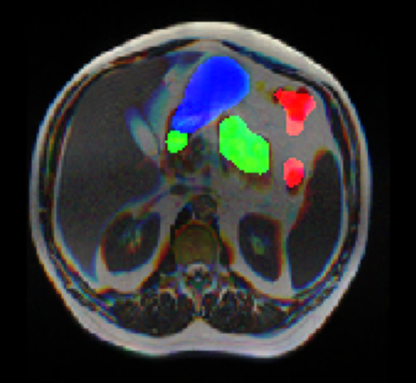
INTRODUCTION
Example - prediction
Notes:
Blue - Stomach
Green - Small intestine
Red - Large intestine

Slide 6
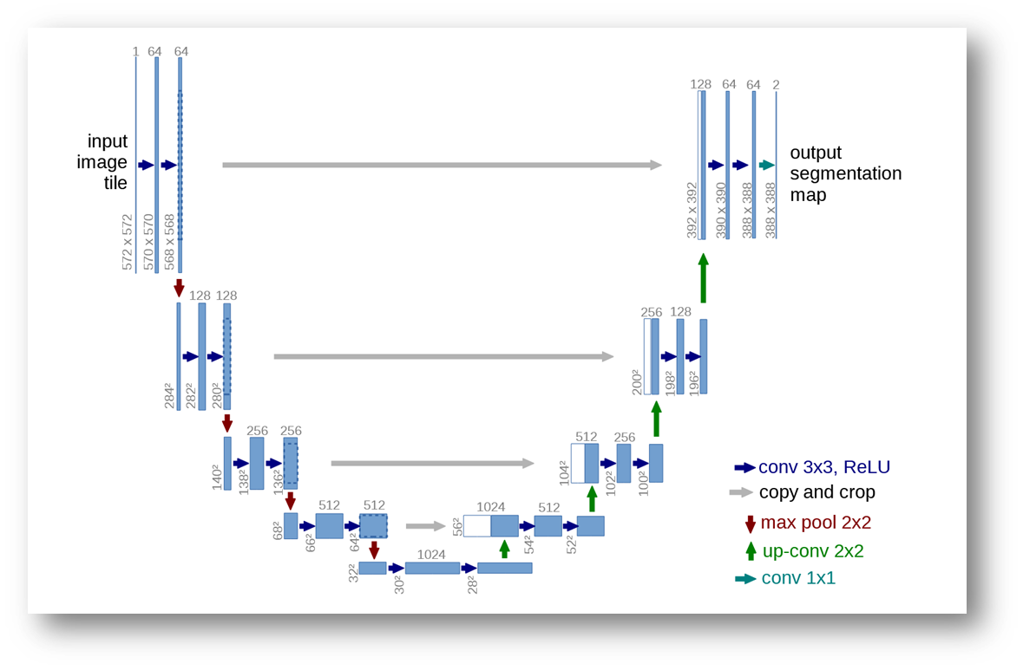
BACKGROUND
U-Net - a medical segmentation architecture

Slide 7
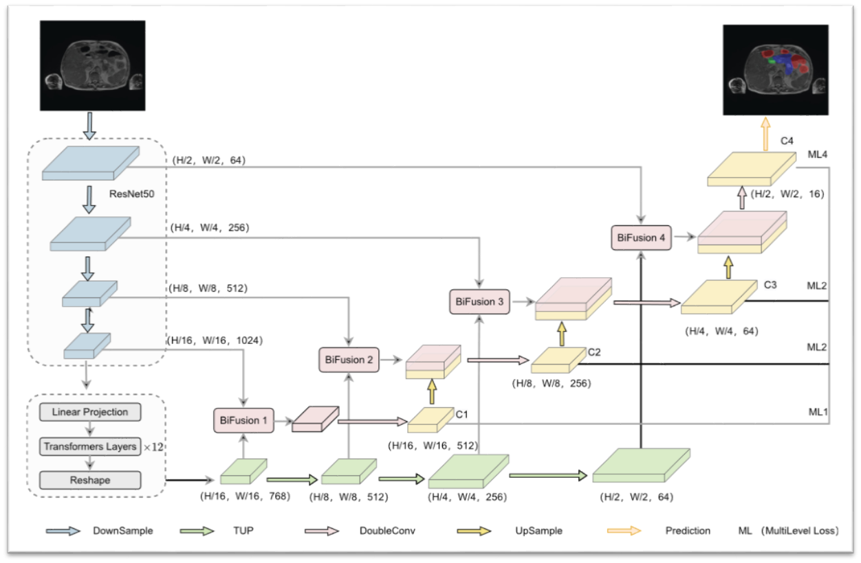
BACKGROUND
BiFTransNet
  A modern U-Net variant utilizing the transformer’s attention mechanism.
  State of the art in 2022.

Slide 8
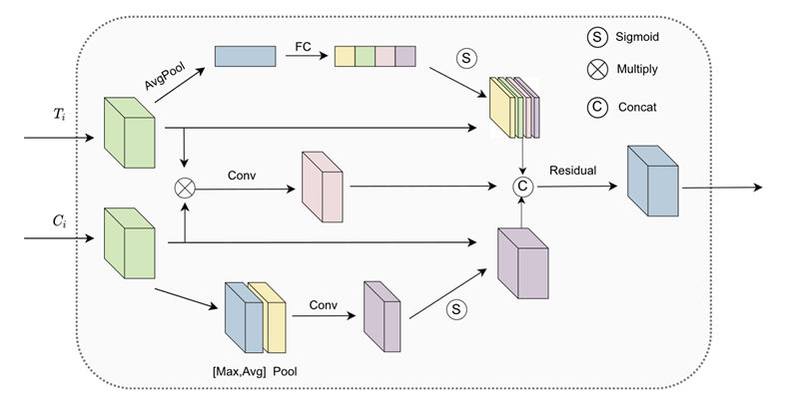
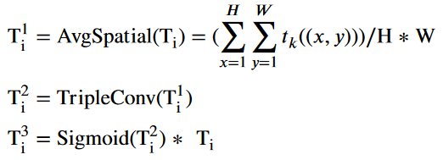
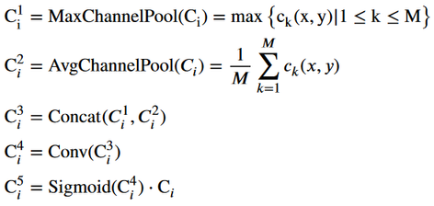
BACKGROUND
BiFTransNet - cont.
  Bi-Fusion
  Transformer Upscale Process (TUP)
  Multi-level loss function
Block diagram of the Bi-Fusion module
The tensor operations inside the top and bottom branches of the BiF block

Slide 9
SOLUTION: OUR MODEL
Multi-scale 2.5D BiFTransNet
  Due to its high-performance, we chose BiFTransNet as our baseline model.
  In the next two slides we will describe our additions to the model
  Our goal in the following modification was not only to improve the model’s learning capabilities, but also not to further tax the computational expenses (GPU memory footprint).

Slide 10
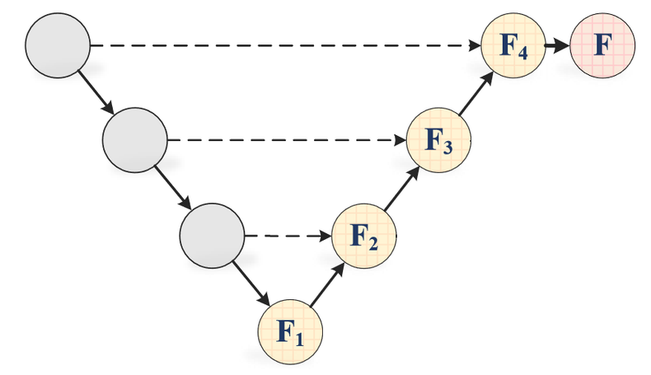
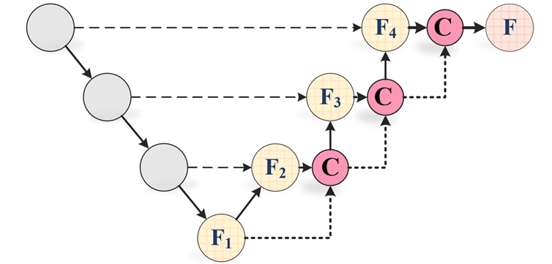
SOLUTION: OUR MODEL - CONT.
Multi-scale skip connections
Standard U-Net topology
Residual multi-scale skip connections

Slide 11
SOLUTION: OUR MODEL - CONT.
2.5D training and Data augmentation
  2.5D training is a training method which adds spatial information to the input image when training sequential data (MRI, CT...). This method combines the RGB channels with the grayscale nature of medical imaging, by inserting three consequent slices along the 3 RGB channels of the model’s input. This allows the model access to additional information, providing additional accuracy.
  Data augmentation: Our dataset is large (~38k slices), but limited in total cases (84), also, a significant portion of the images are empty slices. Extensive data augmentation contributes not only to increased data variability, but also has been shown to help counter overfitting.

Slide 12


SOLUTION: OUR MODEL - CONT.
Hyperparameters and loss function
  140 epochs - increase learning potential.
  Batch size of 64.
  Decaying learning rate - beginning at 0.002, dropping to a minimum of 1e-6.
  We used the Adam optimizer with regularization (weight decay) of 2e-5.
We chose to use the loss function describes in the BiFTransNet paper - a combination of BCE and Tversky loss, as follows:
Tversky loss function

Slide 13
CHALLANGES
Overfitting and hyperparameters adjustments
Due to our dataset’s properties, and the shape of our model, we faced issues related to overfitting (as we will show during the results chapter).
In order to mitigate these issues, we utilized the aforementioned data augmentation, regularization and a large batch size (64).
This combination, along a gradually decaying learning rate, helped mitigate the issue, and the larger batch size also contributed to better accuracy metrics.

Slide 14
CHALLANGES
  Google Drive and Colab - Disconnecting the dataset from the model and crashing during training or downloading.
  Tversky Loss Function - Encountered NaN values in the loss function due to the built-in implementation of Tversky loss and the dataset’s shape.
  Lack of Documentation - Incomplete documentation for BiFTransNet required extensive research into secondary sources to develop the base model.

Slide 15
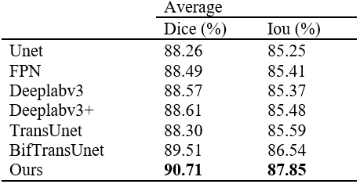
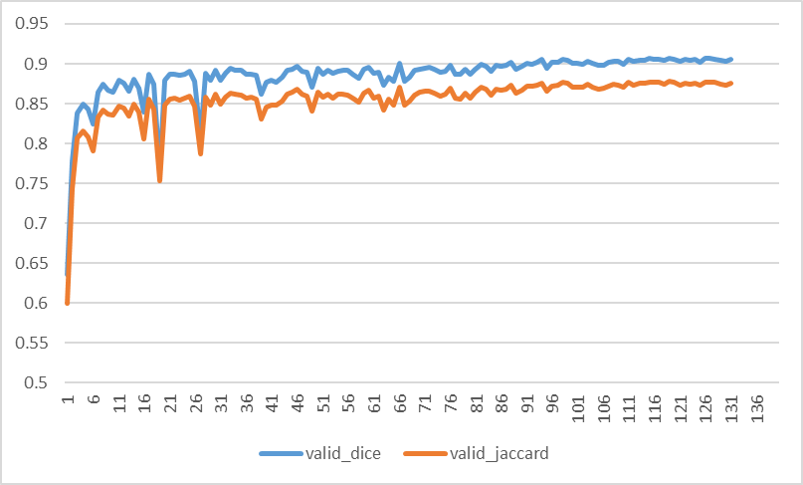
RESULTS - DICE AND IOU
Notes:
כמות האיפוקים הגדולה נתנה תמורה (המשיך ללמוד)
למידה איטית (החל מאיפוק 16)
הפער המשמעותי כנראה נובע מצירוף של דברים = BS + 2.5D + MILTISCALE
NO TIME FOR ABLATION STUDY :(

Slide 16
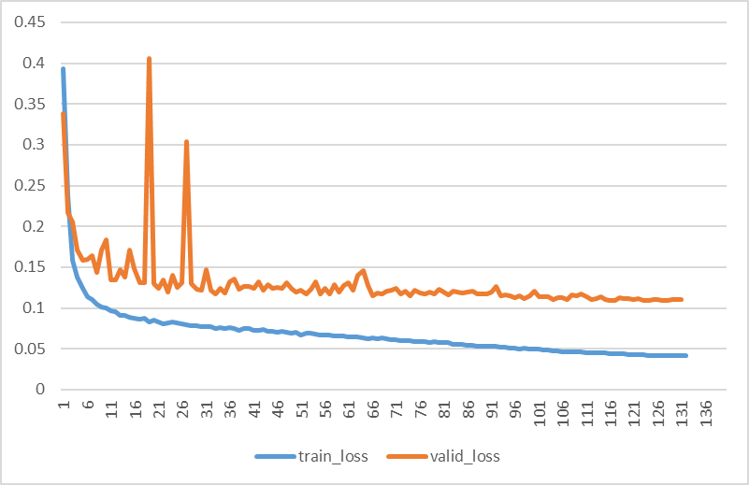
RESULTS - TRAINING AND VALIDATION
  Separating graphs means we have somewhat of an overfitting issue.
  Overfitting mitigation may be possible via the implementation of dropout and\or weight-decay.
Notes:
הגרפים מתרחקים מה שמצביע על OVERFITTING מסויים
ניסויים שונים עם DROPOUTS (מאפס חלק מהניורונים] ורגולרזציה (WEIGHT DECAY)

Slide 17
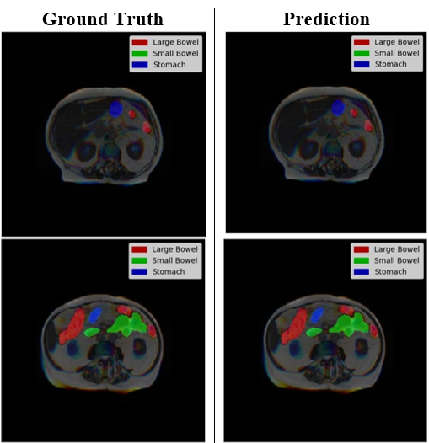
RESULTS
Segmentation results - some examples

Slide 18
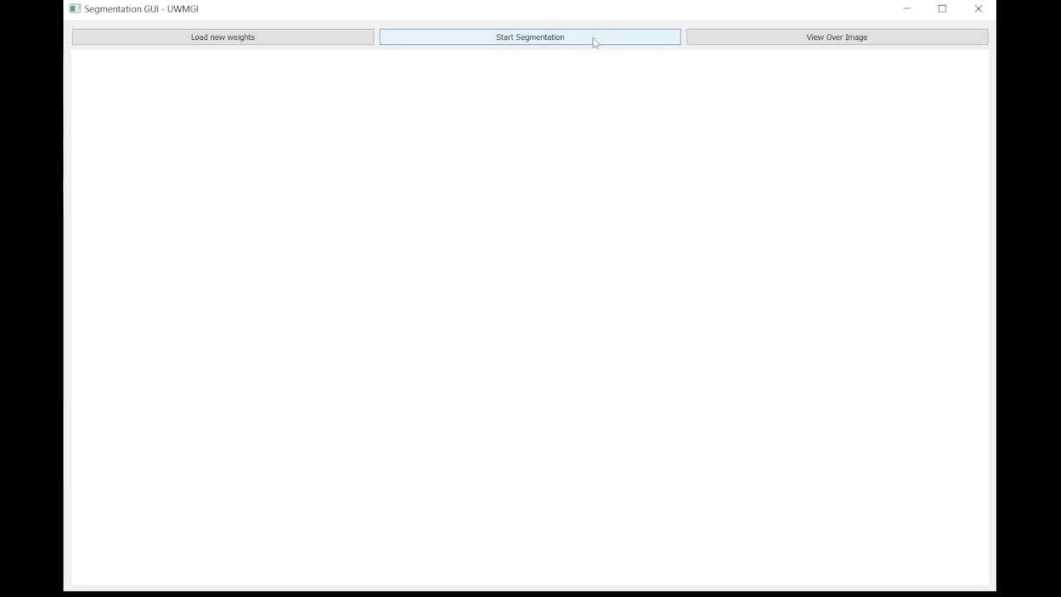
DEMO

Slide 19
CONCLUSION
Our achievements - pros and cons
  Managed to replicate the BiFTransNet model (without source code!)
  Proper hyperparameter choices and multi-scale implementation increased performance.
Still faced overfitting issues, and a low gradient flow in the transformer layers.
Notes:
biftransusen on top of transunet

Slide 20
CONCLUSION
Future work
  Systematic approach to overfitting - dropout, dataset-specific augmentation, other regularization methods.
  Further research in improving transformer gradient flow, use of pre-trained transformer weights to mitigate slow learning.

Slide 21
Thank you!

